Slide 1
Clustering Algorithms in Machine Learning
1. K-Means
2. Hierarchical Clustering
3. DBSCAN
4. OPTICS
5. BisectingKMeans
6. Mean Shift
7. spectral clustering
8. Affinity propagation
9. HDBSCAN
10. Brich clustering

Slide 2
1.K-Means Clustering:
1. Initializing K cluster centers (centroids) randomly
2. Assigning each data point to the closest cluster based on Euclidean distance
3. Updating the cluster centers by calculating the mean of all data points assigned to each cluster
4. Repeating steps 2-3 until the cluster assignments or centroids converge

Slide 3
Advantages of K-Means:
1. Easy to implement
2. Fast
3. Scalable
4. Flexible
5. Interpretable
Disadvantages of K-Means:
1. Sensitive to initial placement
2. Assumes spherical clusters
3. Affected by outliers
4. Difficult to choose K
5. Not suitable for complex clusters

Slide 4
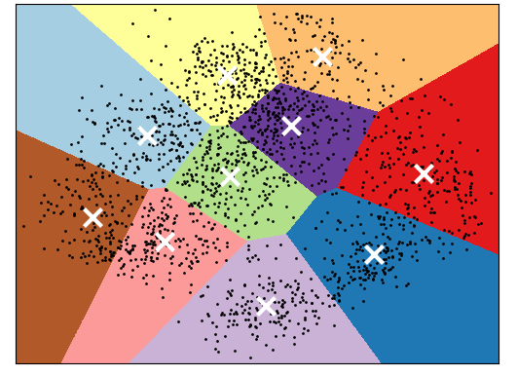
K-means diagram:

Slide 5
2. Hierarchical Clustering:
Hierarchical clustering is a type of unsupervised machine learning algorithm that builds a hierarchy of clusters from the data. It does not require a fixed number of clusters (like K-Means) and instead, it creates a tree-like structure (dendrogram) that shows the relationships between clusters at different levels of granularity.
There are two main types of Hierarchical clustering:
1. Agglomerative: starts with each data point as its own cluster and merges them iteratively into larger clusters.
2. Divisive: starts with all data points in a single cluster and splits them iteratively into smaller clusters

Slide 6
Advantages of Hierarchical Clustering:
1. No need to specify number of clusters
2. Handles varying densities and shapes
3. Visualizes cluster structure
4. Identifies clusters at different scales
5. Flexible and robust
Disadvantages of Hierarchical Clustering:
1. Computationally expensive
2. Difficult to choose linkage criteria
3. Sensitive to noise and outliers
4. Can be difficult to interpret
5. Not suitable for very large datasets

Slide 7
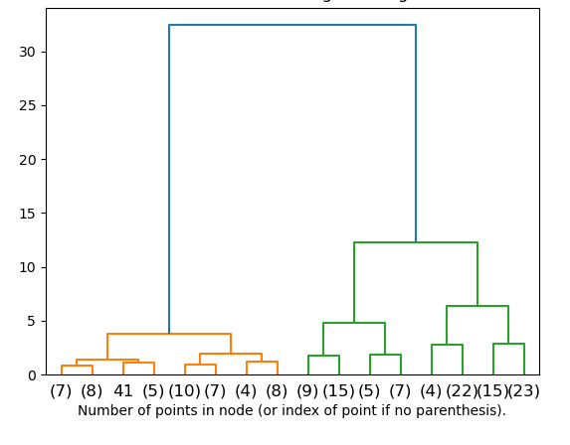
Hierarchical diagram:

Slide 8
3.DBSCAN:
DBSCAN (Density-Based Spatial Clustering of Applications with Noise) is a popular clustering algorithm used in data mining and machine learning. It groups data points into clusters based on their density and proximity to each other, distinguishing them from noise or outliers.
By adjusting ε and MinPts, DBSCAN can be used to identify clusters of varying densities and sizes in datasets.

Slide 9
Advantages of DBSCAN:
1. Handles noise and outliers
2. Finds clusters of varying densities
3. No need to specify number of clusters
4. Robust to noise and outliers
5. Flexible and efficient
Disadvantages of DBSCAN:
1. Sensitive to parameter settings (ε and MinPts)
2. Can be slow for large datasets
3. Not suitable for high-dimensional data
4. Not suitable for clusters with complex shapes
5. Can be difficult to choose parameters

Slide 10
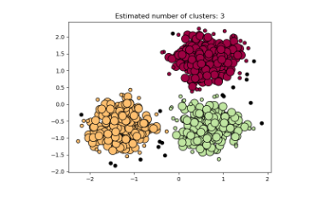
DBSCAN diagram:

Slide 11
4.OPTICS clustering
OPTICS (Ordering Points To Identify the Clustering Structure) is a density-based clustering algorithm that:
1. Builds a density reachability graph
2. Orders points based on their density and proximity
3. Identifies clusters as regions of high density
4. Handles varying densities and noise

Slide 12
Advantages:
- Handles varying densities
- No fixed radius required
- Robust to noise
- Flexible clustering
- Visualizes cluster structure
- No need to specify number of clusters
Disadvantages:
- Computer-intensive
- Difficult to choose parameters
- Not suitable for high-dimensional data
- Not designed for hierarchical clustering
- Sensitive to parameter settings
- Not widely implemented

Slide 13
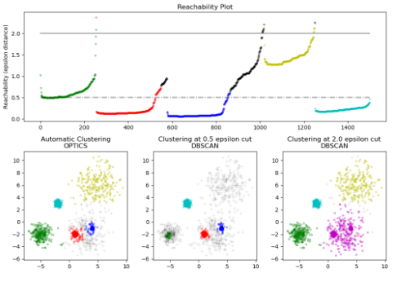
OPTICS diagram:

Slide 14
5.BisectingKMeans:
BisectingKMeans is a variation of the K-means clustering algorithm that splits the data into two clusters at a time, instead of partitioning the data into K clusters simultaneously.
Here's how it works:
1. Initialize a single cluster containing all data points.
2. Split the cluster into two smaller clusters using K-means (bisection).
3. Repeat step 2 for each newly created cluster until the desired number of clusters (K) is reached.

Slide 15
Advantages of BisectingKMeans:
- Fast and efficient for large datasets
- Handles imbalanced clusters well
- Can be used for hierarchical clustering
- Easy to implement
Disadvantages of BisectingKMeans:
- May not find the optimal clustering solution
- Results can depend on the order of splitting
- Can be sensitive to initial placement of centroids
- Not suitable for datasets with complex cluster shapes

Slide 16
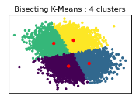
BisectingKmeans diagram:

Slide 17
6.Mean shift
1. Assigns each data point to a cluster based on the density of the surrounding region
2. Updates the cluster center (mean) by shifting it towards the region of highest density
3. Repeats the process until convergence or a stopping criterion

Slide 18
Advantages of Mean Shift:
1. No need to specify number of clusters (K)
2. Handles clusters of varying densities and shapes
3. Robust to noise and outliers
4. Flexible and efficient
5. Can handle high-dimensional data
Disadvantages of Mean Shift:
1. Computationally expensive
2. Sensitive to initial placement of centroids
3. Can get stuck in local optima
4. Requires careful choice of bandwidth parameter (h)
5. Not suitable for clusters with complex structures

Slide 19
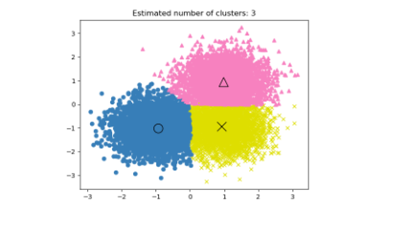
Mean shift diagram:

Slide 20
7. spectral clustering:
1. Build a similarity matrix (e.g., adjacency matrix or kernel matrix) from the data.
2. Compute the eigenvectors of the matrix.
3. Select the k eigenvectors corresponding to the k largest eigenvalues.
4. Treating the eigenvectors as new features, cluster the data points using a clustering algorithm (e.g., K-means).

Slide 21
Advantages of Spectral Clustering:
- Can handle complex cluster shapes and densities
- Robust to noise and outliers
- Works well with high-dimensional data
- Can identify clusters with varying densities
- No need to specify number of clusters (K) beforehand
Disadvantages of Spectral Clustering:
- Computationally expensive for large datasets
- Requires careful choice of similarity matrix and parameters
- Not suitable for very sparse or very dense datasets
- Can be sensitive to scaling and normalization of data
- Not easily interpretable, as clusters are based on eigenvectors

Slide 22
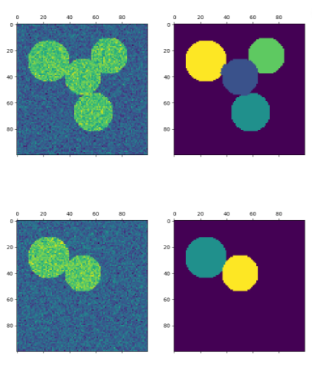
Spectral clustering diagram:

Slide 23
8.Affinity propagation
Affinity Propagation (AP) is a clustering algorithm that identifies exemplars (representative points) and clusters data points around them. It works by:
1. Assigning each data point a preference (e.g., median distance to other points)
2. Iteratively updating the affinities (similarities) between points
3. Selecting exemplars (points with high affinity and preference)
4. Assigning remaining points to the exemplar they are most similar to

Slide 24
The advantages of AP include:
- Robust to noise and outliers
- Handles clusters of varying densities
- No need to specify number of clusters (K)
- Provides exemplars (representative points)
The disadvantages of AP include:
- Computationally expensive
- Requires careful choice of preferences and damping factor
- Not suitable for high-dimensional data
- Can be slow for large datasets

Slide 25
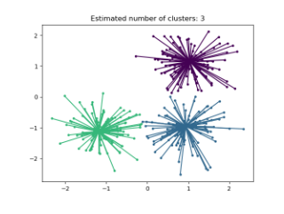
Affinity propagation diagram:

Slide 26
9. HDBSCAN :
HDBSCAN (Hierarchical Density-Based Spatial Clustering of Applications with Noise) is a clustering algorithm that:
1. Builds a hierarchy of clusters based on density and proximity
2. Identifies clusters of varying densities and sizes
3. Handles noise and outliers
4. Does not require a fixed number of clusters (K) as input
5. Provides a hierarchical representation of the data, allowing for visualization and exploration of clusters at different levels of granularity

Slide 27
Advantages of Density-Based Clustering:
1. Handles noise and outliers effectively
2. Flexibility in handling varying densities and cluster shapes
3. No need to specify the number of clusters (K) in advance
4. Can identify clusters of varying sizes and densities
5. Robust to outliers and noise
6. Can handle high-dimensional data
7. Provides a clear separation between clusters and noise
Disadvantages of Density-Based Clustering:
1. Computationally expensive
2. Requires careful parameter tuning (e.g., epsilon, minPts)
3. Can be sensitive to the choice of distance metric
4. May not work well with clusters of varying densities
5. Can be difficult to choose the optimal parameters
6. May not be suitable for data with a large number of dimensions
7. Can be slow for large datasets

Slide 28
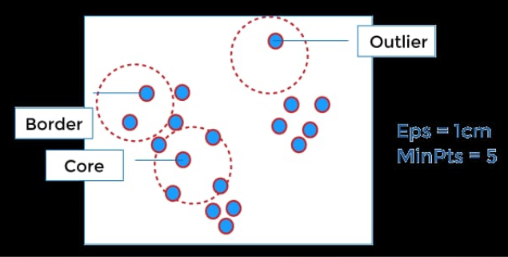
Density based clustering diagram:

Slide 29
10. Brich clustering
BIRCH (Balanced Iterative Reducing and Clustering using Hierarchies) is a clustering algorithm that:
1. Builds a hierarchical clustering structure (tree-like)
2. Divides data into clusters based on density and proximity
3. Uses a threshold (radius) to determine cluster boundaries
4. Iteratively refines clusters, balancing size and density

Slide 30
Advantages of BIRCH Clustering:
- Handles large datasets efficiently
- Memory efficient
- Fast clustering
- Handles noise and outliers effectively
- Incremental clustering (can handle new data points)
Disadvantages of BIRCH Clustering:
- Sensitive to parameter settings
- Limited ability to handle non-spherical clusters
- Limited flexibility in distance metric choice
- Can only process metric attributes
- Requires careful parameter tuning
- Can be slow for very large datasets

Slide 31
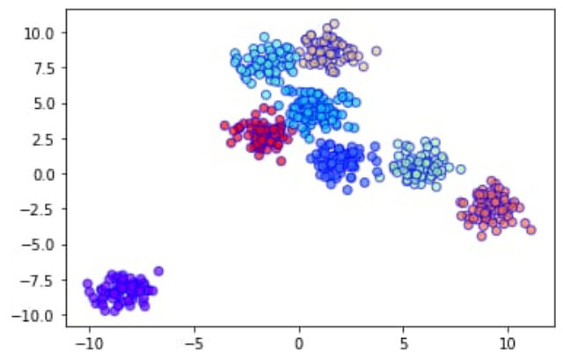
Brich clustering:

